Slide 1
Blockchain

Slide 2
What is Blockchain Technology:
A blockchain public ledger that keeps a shared record of all the transactions ​distributed over a vast network of users. ​
It is decentralized network and doesn’t require any intermediate system for ​the exchange of services.​
The primary use of blockchains is as a distributed ledger for cryptocurrencies.
Example Bitcoin stores all its transactions onto a public database called as Blockchain.​
Blockchain placed information in a secure way because of it following cryptography hashing technic.

Slide 3
Blockchain Version:
The brief description of the evolution of blockchain technology and its versioning from 1.0 to 3.0 are explained below.
1) Blockchain 1.0: Currency
3) Blockchain 2.0: Smart Contracts
4) Blockchain 3.0: DApps

Slide 4
Blockchain 1.0: Currency
The idea of creating money through solving computational puzzles was first introduced in 2005 by Hal Finney, who created the first concept for cryptocurrencies (The implementation of distributed ledger technology).
This ledger allows financial transactions based on blockchain technology or DLT to be executed with Bitcoin. Bitcoin is the most prominent example in this segment.
It is being used as cash for the Internet and seen as the enabler of an Internet of Money.

Slide 5
Blockchain 2.0: Smart Contracts
The main issues that came with Bitcoin are wasteful mining and lack of network scalability. To overcome these issues, this version extends the concept of Bitcoin beyond currency.
The new key concepts are Smart Contracts. It is small computer programs that "live" in the blockchain.
The blockchain 2.0 version is successfully processing a high number of daily transactions on a public network, where millions were raised through ICO (Initial Coin Offerings), and the market cap increased rapidly.

Slide 6
Blockchain 3.0: DApps
DApps is also known as a decentralized application.
It uses decentralized storage and communication.
Its backend code is running on a decentralized peer-to-peer network.
A DApp can have frontend code hosted on decentralized storages such as Ethereum Swarm and user interfaces written in any language that can make a call to its backend like a traditional Apps.

Slide 7
Blockchain main uses:
The primary use of blockchains is as a distributed ledger for cryptocurrencies.
A blockchain is a concept of storing data digitally.
This data comes in blocks. These blocks are chained together and make the data immutable.
When a block of data is chained with the other blocks, its data can never be changed again.

Slide 8
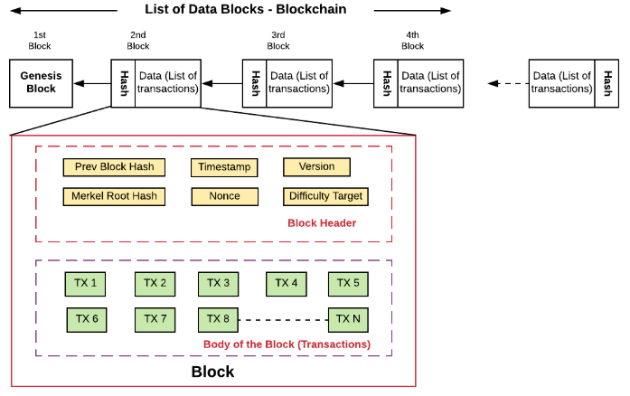
T
How Hashes are using in Blockchain:
Transactions
Transactions

Slide 9
Blockchain is a System Comprised of:
Distributed ledger
Coinbase Transaction
Basic Components of Bitcoin
Blockchain Proof of work
Key Concepts of Bitcoin
Blockchain Key Areas
Blockchain Cryptocurrency
Blockchain DAO(Decentralized Autonomous Organization)
Blockchain Bitcoin Cash

Slide 10
Blockchain vs Bitcoin:
The goal of blockchain is to allow digital information to be recorded and distributed, but not edited. The Bitcoin protocol is built on the blockchain.
In a research paper introducing the digital currency, Bitcoin’s pseudonymous creator Satoshi Nakamoto referred to it as “a new electronic cash system that’s fully peer-to-peer, with no trusted third party.”

Slide 11
The key business benefits:
• Time savings
• Cost savings
• Tighter security
• Enhanced privacy
• Improved auditability
• Increased operational efficiency

